Slide 1
CubeSat Electronic Boards Design
CANADIAN CUBESAT PROJECT:
Andrew Wong, James Sands, Keith Mody, Patrick Zwinkels

Slide 2
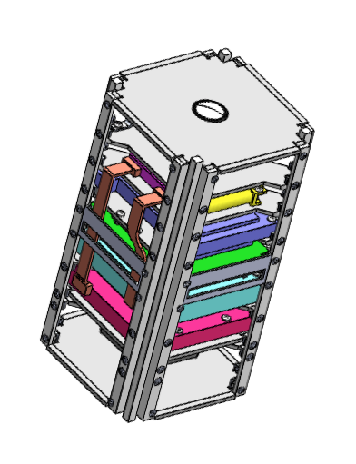
Background Information
What is a CubeSat?
A miniature prism shaped satellite
10cm x 10cm x 20cm dimensions (x,y,z)
Aluminum structure holds all components
What can CubeSats do?
Launch from the ISS to record 360° view via Canadensys Nano VR cameras (2)
Communicate with and transmit data to the ground station
What is the reason for CubeSat projects?
Used for more research into the field, as well as education purposes
Experience for students in developing flight hardware and conducting space missions
To enhance the existing circuits of the CubeSat for the likelihood of a more successful mission

Slide 3
Design Concept
What is our team’s mission?
To have a timer circuit lasting at least 30-minutes to simulate the launch time from the ISS
Have this timer circuit start a burn wire circuit to melt through fluorocarbon line releasing the antennas
To combine these circuits into PCB’s to demonstrate
General overview of the CubeSat mission
The CubeSat involves many teams, having different roles in the mission
Our team deals with the space segment, but we need to communicate with the ground station with a fellow teams software

Slide 4
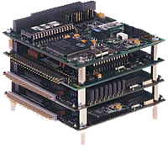
PC104 Stack
-A stackable computer system consisting of a CPU, power supply, and peripherals
-Standardized in 1992, but now used in applications in specialized environments
-Pins fit into each other allowing multiple boards to be stacked on top of and interface with one another

Slide 5
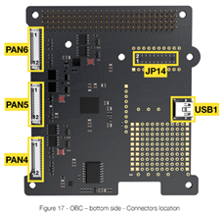
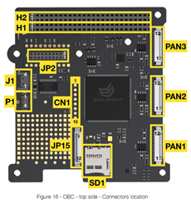
On-Board Computing (OBC)
A complete computer built on a single circuit board, with a microprocessor, memory input/output and other features required of a functional computer
Functions as the CPU (Central Processing Unit) of the CubeSat
Connects to the PCB via the PC104 stack and communicates with all sensors

Slide 6
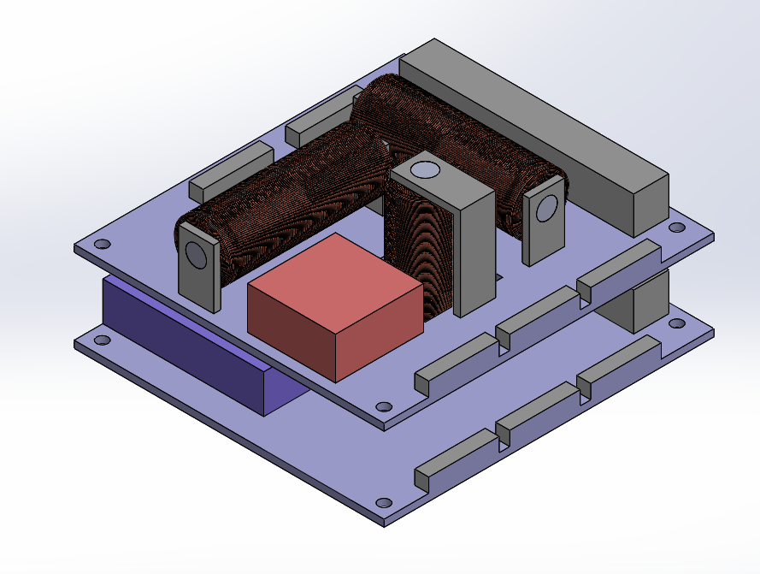
Magnetorquers
-Electromagnetic coils which create a magnetic dipole in order to produce torque for attitude control and stabilization
-Three coils will be used, one along each axis (x,y,z) to allow for rotation in any direction
-Located in centre of boards for optimal rotation
-Connected to OBC using picoblade connectors and PWM

Slide 7
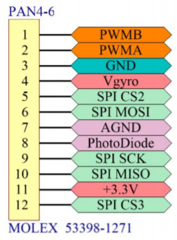
Sensors
Gyroscope: Measures rotation of the CubeSat. Connects to OBC via a picoblade connector and communicates using SPI protocol.
Temperature Sensor: Measures temperature of multiple locations of the CubeSat. Connects to OBC through GPIOs on the PC104 stack.
Exact components have not yet been decided but placeholder spaces have been left on board 2

Slide 8
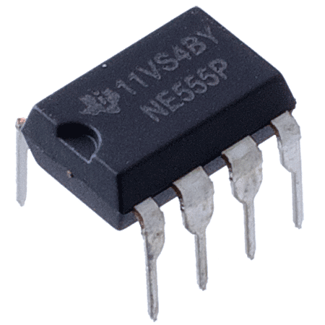
555 Timer Circuit
-Used to buffer CubeSat start up
-Prevents CubeSat from powering on early and endangering astronauts
-Equivalent resistances and capacitances calculated to achieve target 30 minute time with minimal number of components
-Taking picture as CubeSat is being launched from ISS

Slide 9
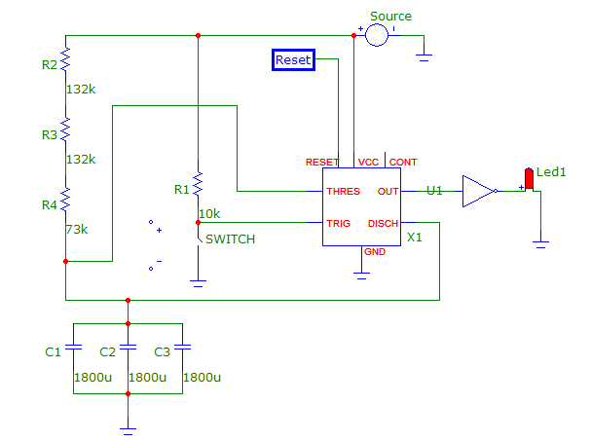
555 Timer Implementation
Finalized timer circuit created via MicroCap

Slide 10
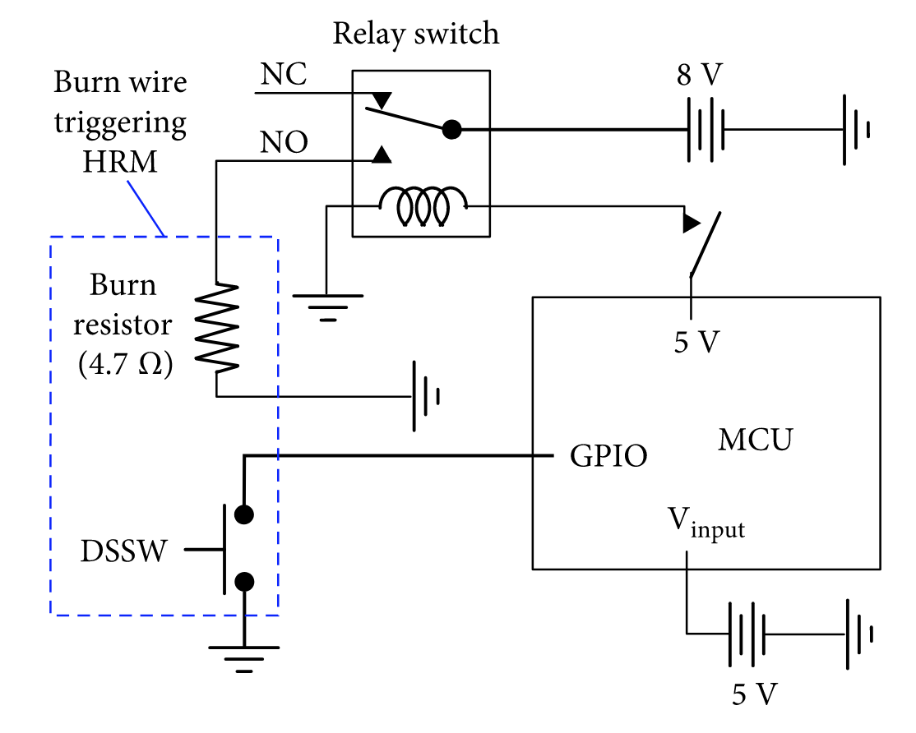

Burn Wire Circuit
Used to deploy antennae 30 minutes after launch
Makes use of a general purpose relay and flameproof resistor
Successfully melts the wire through contact
Antennae spring outward after wire is broken
Schematic of the Burn Wire System

Slide 11
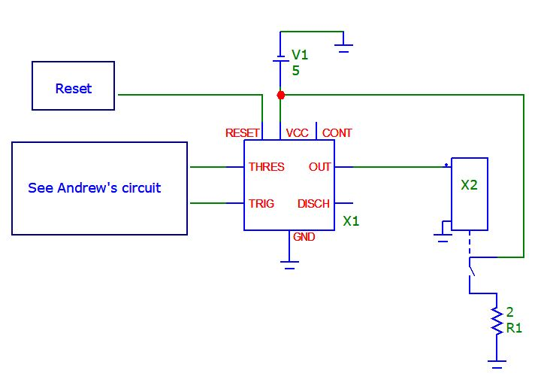
Burn Wire MicroCap Implementation
Burn wire schematic compared to MicroCap creation

Slide 12
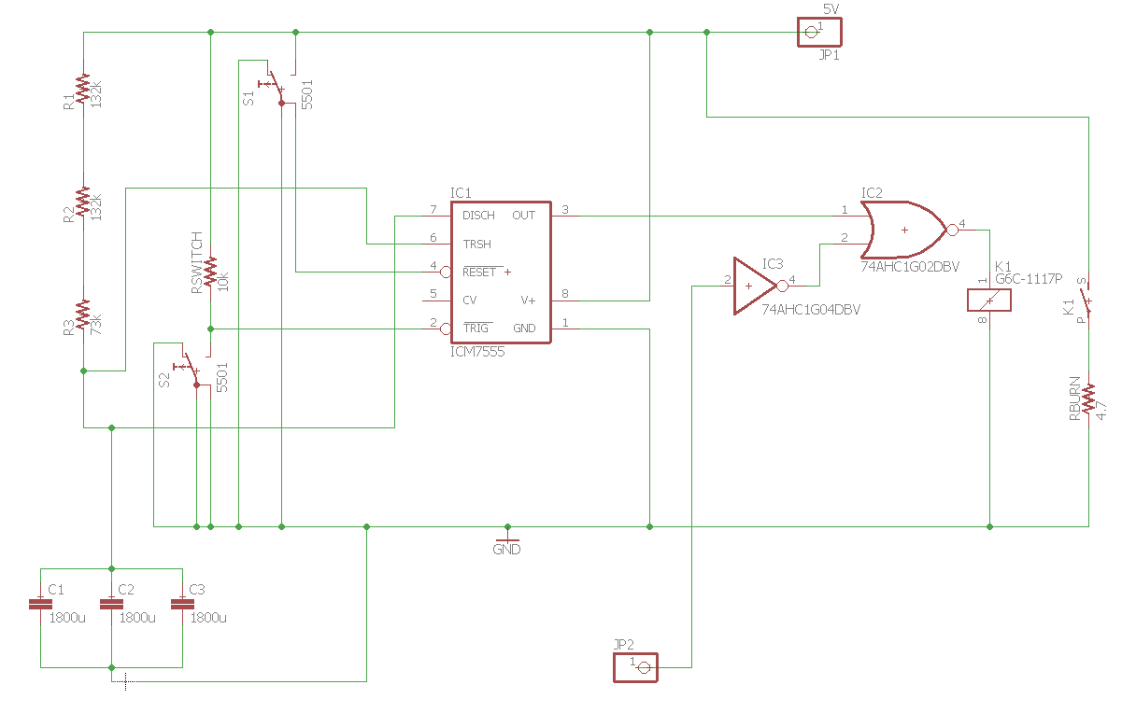
Combined Burn Wire and Timer Circuit

Slide 13
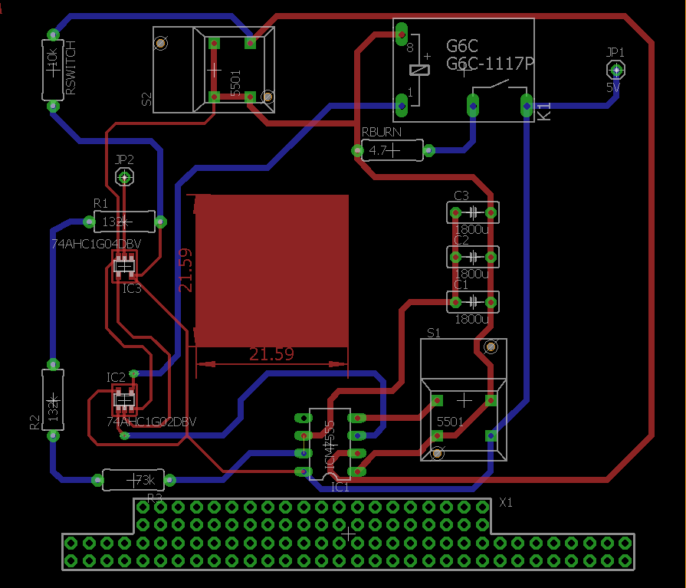
Preliminary PCB Design
Board 1:

Slide 14
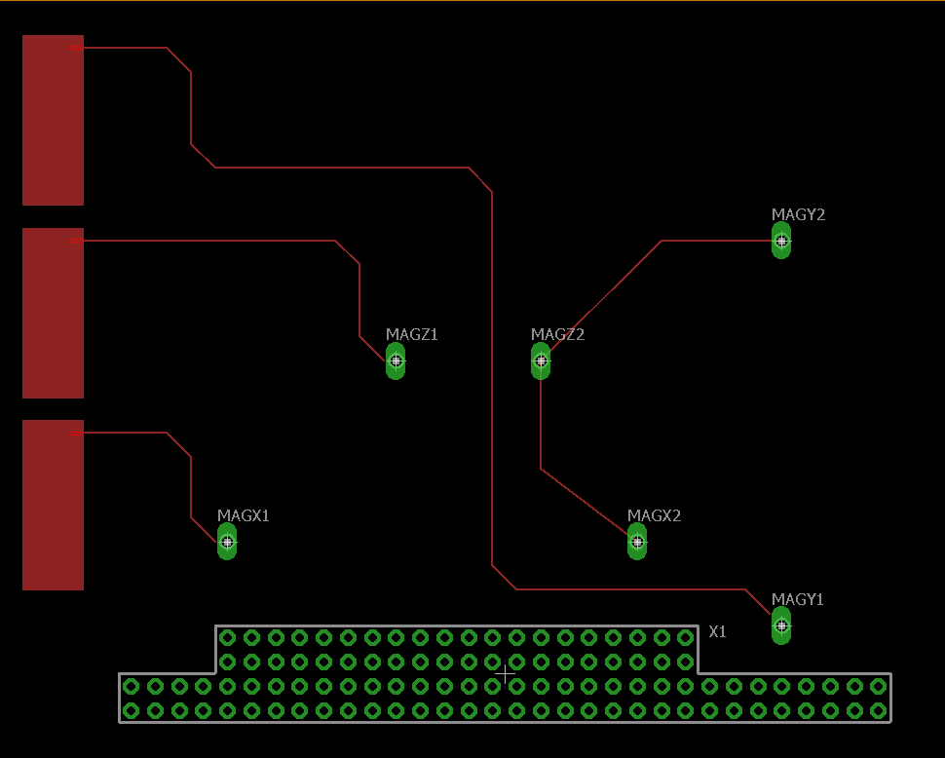
Preliminary PCB Design
Board 2:

Slide 15
Testing Strategy
Burn Wire:
Two 5 Volt power supplies will simulate the voltage sources
Wire will be wrapped around the burn resistor
clamps will hold the wire in tension
Current will go through the circuit and heat up the resistor (to about 300°) to melt the fluorocarbon wire
Testing will begin once all needed parts are received
555 Timer:
5V power supply will be connected to assembled circuit
LED and voltmeter will be at output as indicators of circuit’s performance
A stopwatch will be used to time the results for accuracy

Slide 16
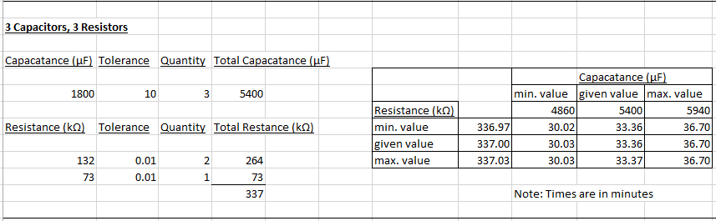
555 Timer Theoretical Results

Slide 17
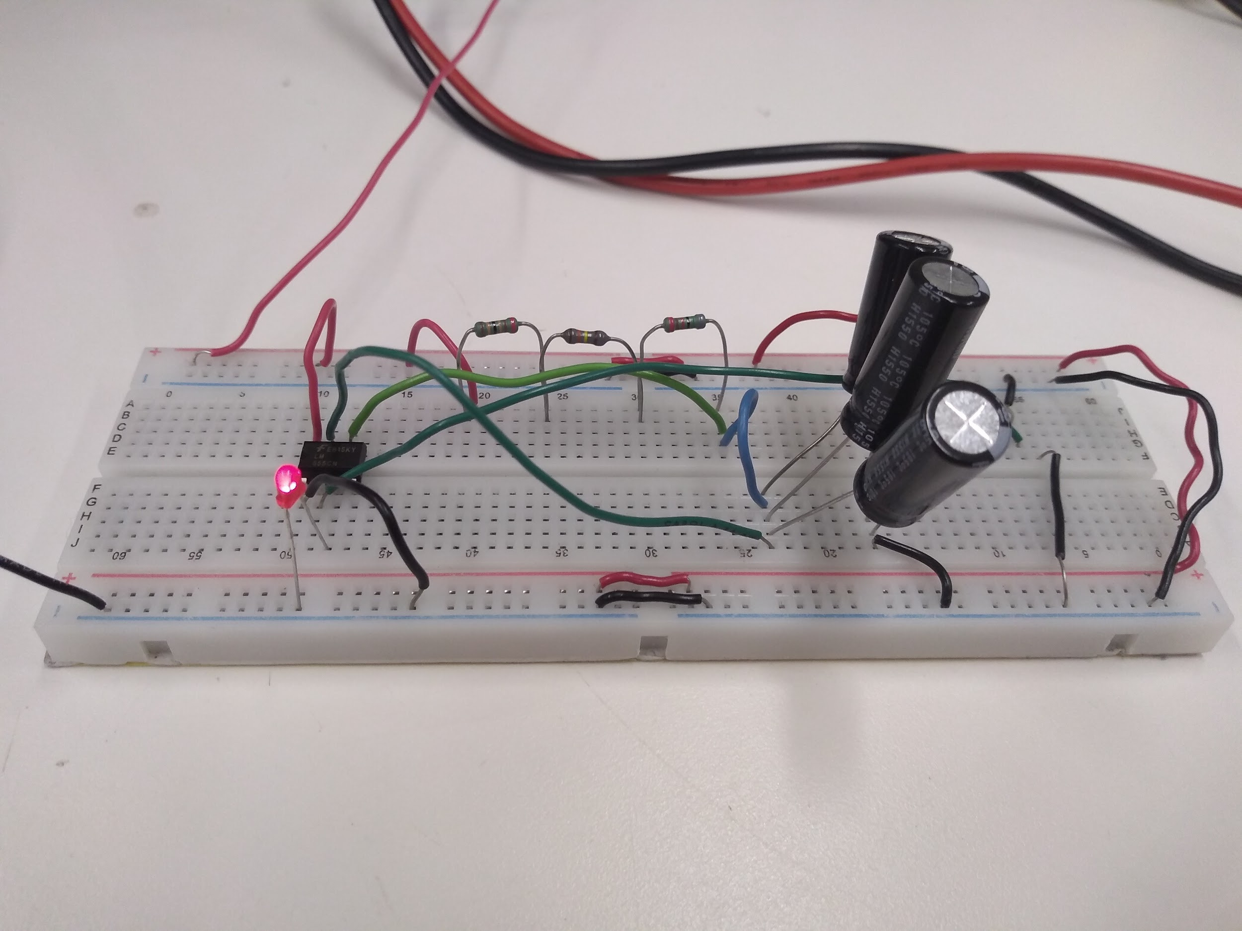
Preliminary Results
555 Timer:
-Performed 2 successful trials
-Time slightly less than 30 minutes exactly mostly likely due to non ideal parts
-Prototyped circuit concept proven
-Next steps: Sourcing space rated components for further testing

Slide 18
Next Steps
-Collect burn-wire circuit data
-Add all remaining components to board 2
-Create PCB layout using Altium software
-Finalize PC104 connections with OBC team to determine pinout and routing strategy
-Print first iteration of PCBs

Slide 19
Questions?

